Slide 1
Volunteer Me
2080613 Seoras Macdonald
2084246S Rhianna Jade Scott
2063602 Charles Henry Thomas Townley

Slide 2
Storing personal details
Storing details of the times he is available
Searching for opportunities in the chosen field/area/time
Storing searches
Applying easily without filling out the form more than once
Finding out if he has been accepted.
Replying to organisers
Name: James
Category to Volunteer in : Administrative work
Occupation: Student
Volunteer Time : evenings and weekends
Ares willing to travel to: West of Glasgow
Description:
Has class during the day but wants to volunteer to further his career and cv.
Has experience working with the basic administrative tools.
Would like to volunteer in a charity store or organisation aimed towards helping the sick
Willing to travel but prefers to stay in the west of Glasgow

Slide 3

Name: Glasgow Royal Infirmary
Area: East Glasgow
Area of volunteer: Charity shop/retail, catering, Administrative/Office work
Description:
The hospital needs volunteers to run the small store that runs from 9am – 4 pm, volunteers that will help in the cafeteria and volunteers that will help with paperwork and basic administrative tasks
They would like experience but are willing to train people on a case by case bases
Daily tasks
Catering – Setting/ cleaning tables, Washing dishes, Setting up and closing down, Helping cook
Admin – basic tasks.
Retail - basic customer interaction, sorting and storing items, opening closing the store,
Making the each opportunities available quickly and easily
Reviewing the volunteers that apply for it
Contacting the volunteers
Changing the details/deleting of each opportunity as places are filled
Adding other opportunities as they become available
Renew old opportunities

Slide 4
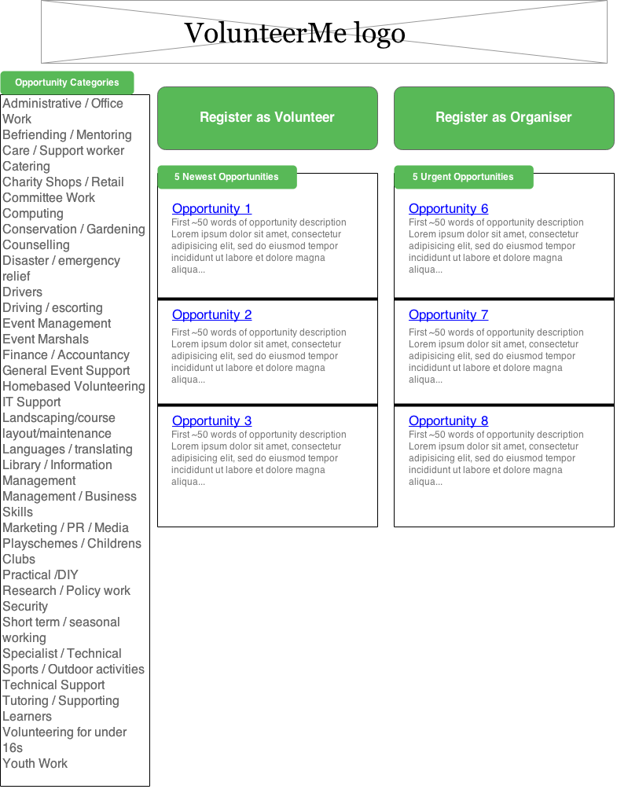
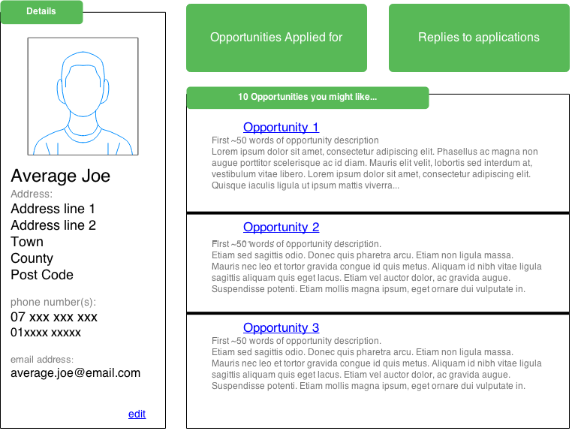

Slide 5
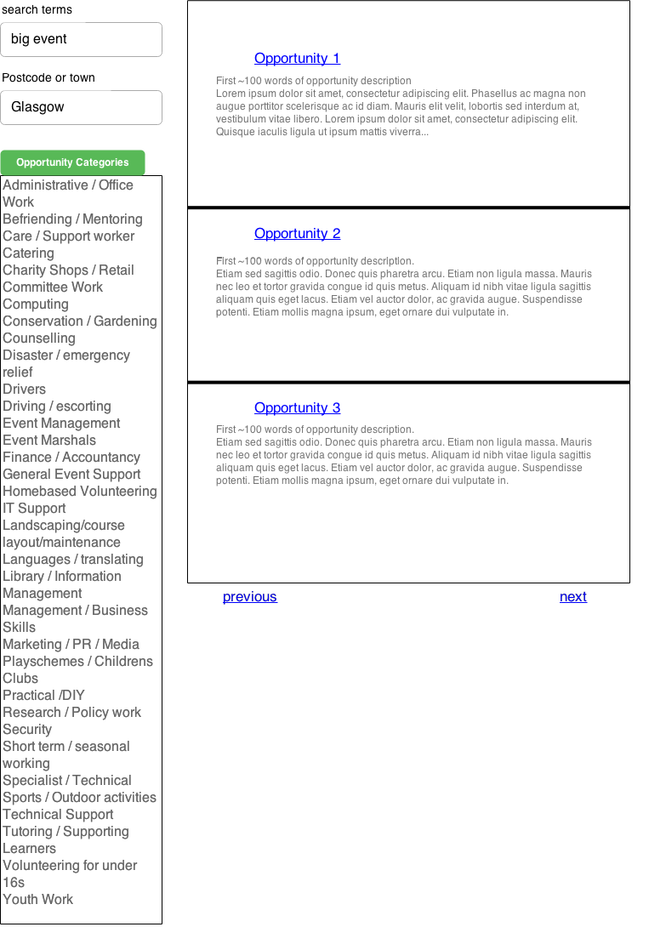

Slide 6
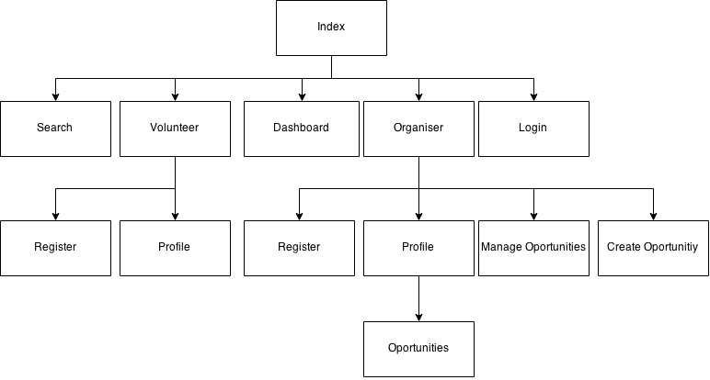
Site Map:
www.volunteerme.com/
www.volunteerme.com/search
www.volunteerme.com/login
www.volunteerme.com/dashboard
www.volunteerme.com/volunteer/<volunteer>
www.volunteerme.com/volunteer/register
www.volunteerme.com/organiser/register
www.volunteerme.com/organiser/<organiser>
www.volunteerme.com/organiser/<organiser>/<opportunities>
www.volunteerme.com/organiser/manage-opportunities
www.volunteerme.com/organiser/create-opportunities

Slide 7
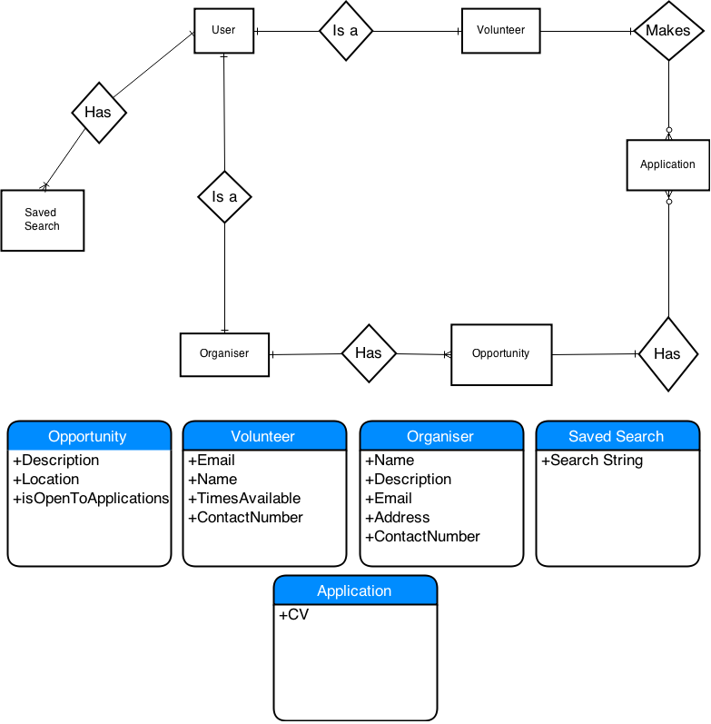
ER diagram

Slide 8
Specification list:
Must be able to
Volunteers
Search for opportunities
Volunteer for opportunities
Edit/create personal details
Organisers
Post/edit opportunities
Delete opportunities
Create/maintain profile
View reply’s

Slide 9
Should be able to
Volunteers
Save searches
Post cv’s
Organisers
Edit/create details for accounts
Renewing old opportunities

Slide 10
Would like to be able to
• Organisers can see how their opportunity is being seen by volunteers
• Map separated by county then smaller regions
• Mass contact tools for organisers

Slide 11
Any Questions ?

